Slide 1
CROSSING OVER

Slide 2
INTRODUCTION
Crossing Over refers to the interchange of part between non-sister chromatids of homologous pair during meiotic prophase (pachytene). It means that, the genetic materialis exchanged between non-sister chromatids by breakage and reunion at a specific point. The term ‘crossingover’ was first used by Morgan and Cattellin 1912. Main features of crossing over are as follows
1.Crossing over happens during meiotic prophase i.e.during pachytene. Each pair of homologous chromosome has four chromatids at such time
2.Crossing over takes place between two non-sister chromatids. i.e. One chromatid from each of the chromosome is involved in the process of crossing over.
3.It is universally accepted that crossing over occurs at four strand stage
4.Double or multiple crossing over may occupy all four, three or two of the four chromatids, which is very rare.
5.Crossing over directs to recombination or new combinations between linked genes i.e. It generally build up two recombinant types or crossover types and two parental types or non-crossover types
6.It leads to exchange of equal segments or genes and recombination is always reciprocal. However, in some cases unequal crossing over has also been reported

Slide 3
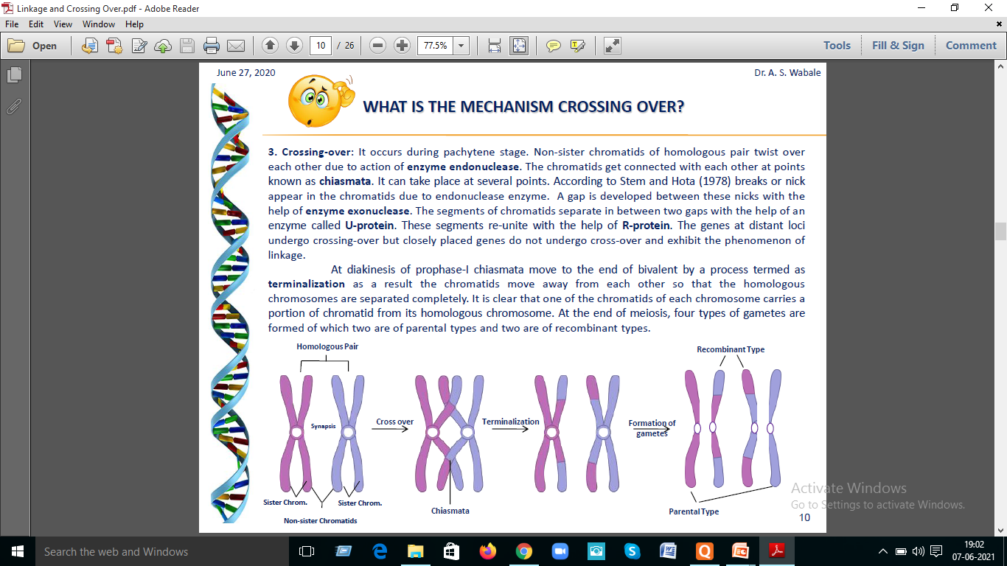

Slide 4
Mechanism of crossing over: It is responsible for recombination between linked genes and takes place during pachytene stage of meiosis i.e. after the homologous chromosomes have undergone pairing and before they begin to separate. It occurs through the process of breakage and reunion of chromatids.
During pachytene, each chromosome of a bivalent (chromosome pair) has two chromatids so that each bivalent has four chromatids or strands (four-strand stage). Generally one chromatid from each of the two homologues of a bivalent is involved in crossing over. In this process, a segment of one of the chromatids becomes attached in place of the homologous segment of the non sister chromatid and vice-versa. It is assumed that breaks occur at precisely homologous points in the two non sister chromatids involved in crossing over; this is followed by reunion of the acentric segments. This produces a cross (x) like figure at the point of exchange of the chromatid segments.

Slide 5
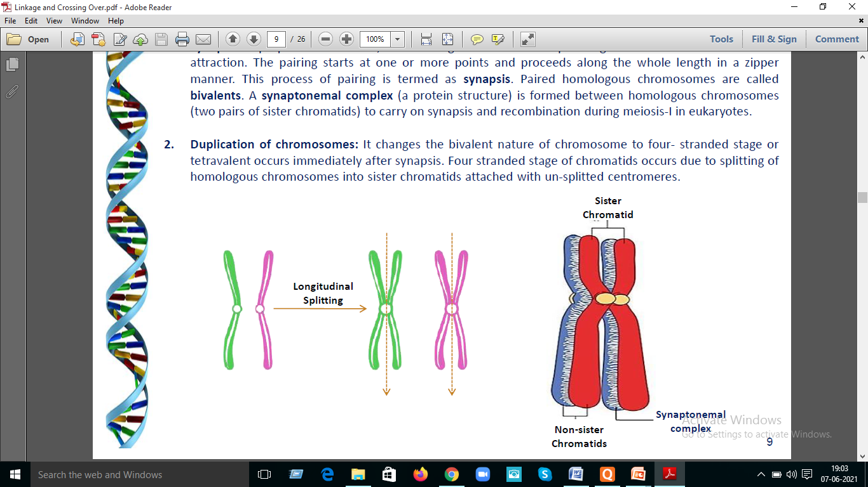

Slide 6
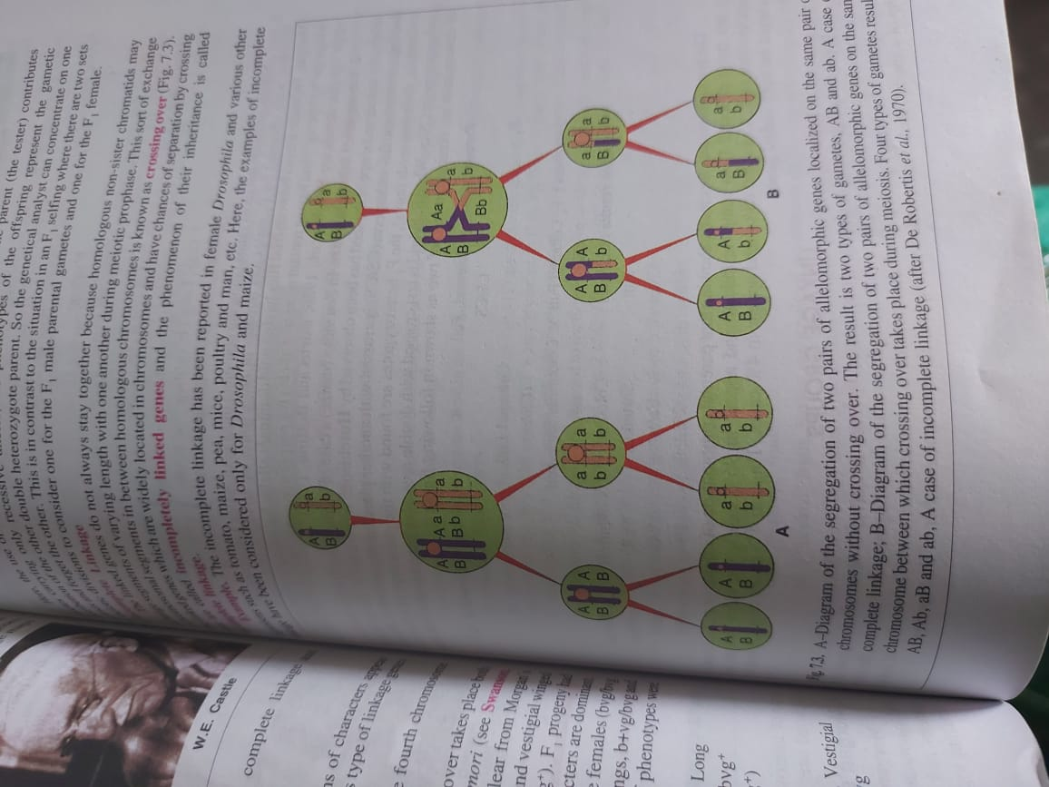

Slide 7
Types of crossing over: Depending upon the number of chiasmata involved, crossing over is of three types.
1. Single crossing over: It refers to the formation of single chiasma between non-sister chromatids of homologous chromosomes. It involves two linked genes (Two point test cross).
2. Double crossing over: It refers to the formation of two chiasmata between non-sister chromatids of homologous chromosomes. It involves three linked genes (Three point test cross).
3. Multiple crossing over: Occurrence of more than two crossing overs between non-sister chromatids of homologous chromosomes is known as multiple crossing over. However, the frequency of such type of crossing over is extremely low.

Slide 8
Factors affecting crossing over: The frequency of crossing over between the linked genes is affected by several factors.
1. Distance between the genes: The frequency of crossing over between the two genes is positively associated with the distance between their location in the chromosome. Crossing over between the two genes would increase with an increase in distance between them.
2. Sex: The frequency of recombination is markedly influenced by the sex of heterozygotes for linked genes. In general, the heterogametic sex shows relatively lower recombination frequencies than the homogametic sex of the same species.

Slide 9
3. Age of female: The frequency of crossing over shows a progressive decline with the advancing age of Drosophila females.
4. Temperature: In Drosophila, the lowest frequency of crossing over is observed when females are cultured at 220C. The frequency of recombination tends to increase both at the lower and higher temperatures than 220C.
5. Nutrition: The frequency of crossing over in Drosophila is affected by the presence of metallic ions Eg: Ca+2 and Mg+2 in its food. Higher the amount, lower will be the crossing over frequenc y and vice-versa.
6. Chemicals: Treatment of Drosophila females with certain antibiotics like mitomycin D and actinomycin D and certain alkylating agents such as ethylmethane sulphonate promotes crossing over.
7. Radiations: An increase in frequency of crossing over is observed when Drosophila females are irradiated with x-rays and g-rays.
8. Plasmagenes: In some species, plasma genes reduce the frequency of crossing over. Eg: The Tifton male sterile cytoplasm reduces the frequency of crossing over in bajra.

Slide 10
9. Genotype: Many genes are known to affect the occurrence as well as the rate of crossing over. For example C3G gene of Drosophila located in chromosome 3 prevents crossing over when present in homozygous state while it promotes crossing over in the heterozygous state.
10.Chromosomal aberrations: In Drosophila, some chromosomal aberrations Eg: paracentric inversions, reduce recombination between the genes located within the inverted segment.
11.Distance from centromere: Centromere tends to suppress recombination. Therefore genes located in the vicinity of centromeres show a relatively lower frequency of crossing over than those located away from them.

Slide 11
Significance of crossing over in Plant Breeding:
1. It increases variability
2. It helps to break linkages
3. It makes possible to construct chromosome maps

Slide 12
